Slide 1

AI-Powered Assistive Technology: Helping Visually Impaired Individuals
This presentation will explore the potential of AI-powered assistive technology to improve the lives of visually impaired individuals.

Slide 2
Project Overview
Goal
Methodology
Develop a system to aid visually impaired individuals by providing audio assistance.
Utilizing deep learning techniques, particularly object detection and image captioning, to process images captured from a camera and generate descriptive audio feedback.

Slide 3
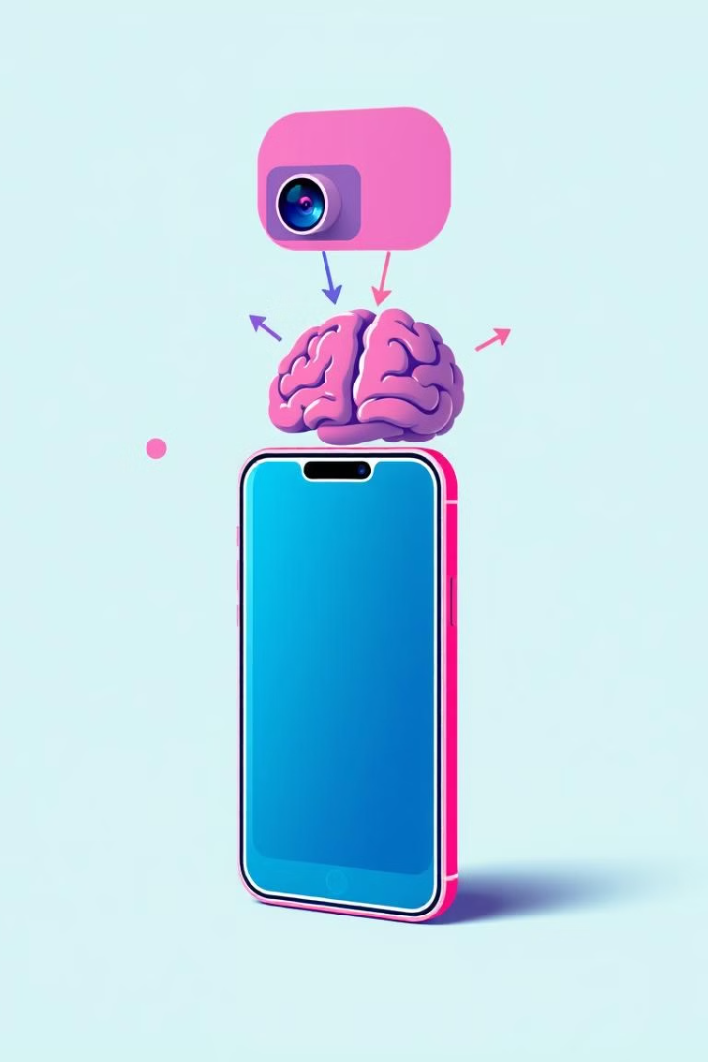
Core Technical Components
1
Object Detection
2
Image Captioning
Detects and identifies objects within the images.
Generates descriptive captions based on the identified objects and scene context.
3
Text-to-Speech
Converts the generated captions into spoken audio output.

Slide 4





Key Functionality
Image Capture
Captures images from a camera.
Object Detection
Detects objects within the images.
Caption Generation
Generates descriptive captions for the images.
TTS Conversion
Converts captions to spoken audio using TTS.
Real-time Feedback
Provides real-time audio feedback to the user.

Slide 5

Potential Impact
Enhanced Independence
Safe Navigation
Enhances independence and mobility for visually impaired individuals.
Provides a safe and efficient way to navigate surroundings.
Improved Quality of Life
Improves overall quality of life.

Slide 6
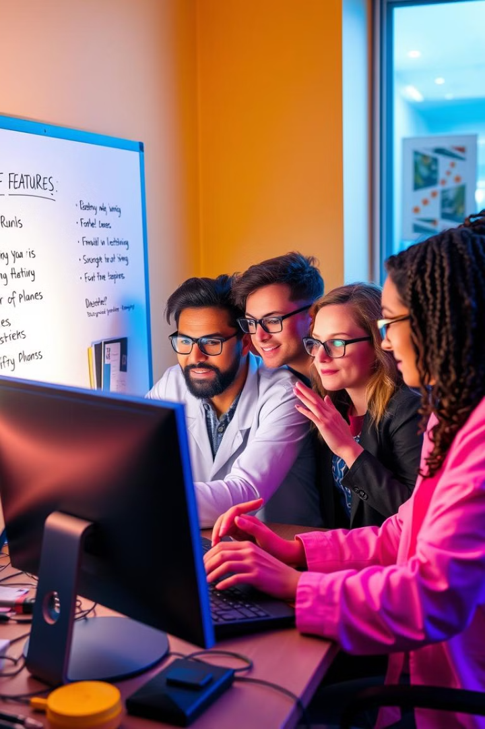



Future Development
Face Recognition
Model Improvement
Integration
Incorporating other features like face recognition.
Integrating with other assistive technologies.
Improving the accuracy and efficiency of object detection and image captioning models.

Slide 7

Key Takeaways
AI Impact
1
AI can revolutionize accessibility for visually impaired individuals.
2
Accessibility
This technology can improve independence and quality of life.
Innovation
3
Further development holds exciting possibilities for enhancing functionality.

Slide 8
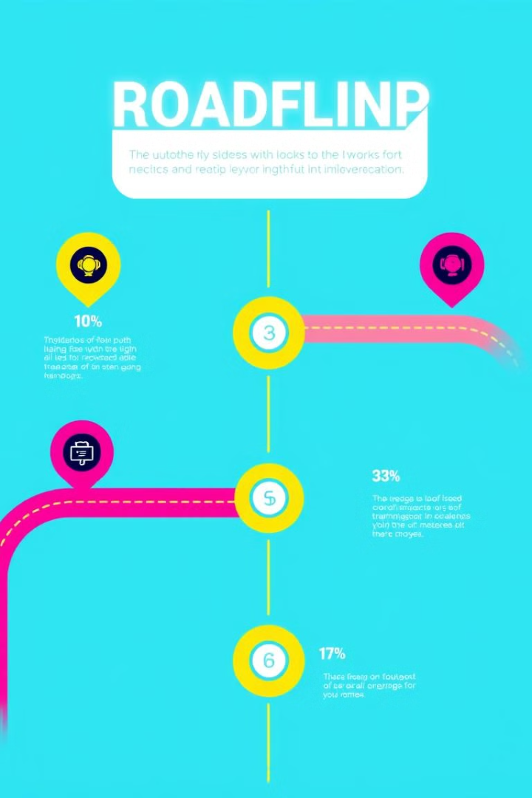
Next Steps
The next steps involve continued research, refinement of the AI models, and collaboration with stakeholders to ensure the technology is accessible and user-friendly.

